Slide 1
Analyzing Correlation Between Hourly Calories Burned and Steps Taken

Slide 2
The purpose for this analysis is to find the correlation between calories burned and steps taken.
This was an hourly study that lasted for a week ( between 10/1/2017 and 10/8/2017)
I used google sheets as the primary analytical tool following the ASK, PREPARE, PROCESS, ANALYZE, SHARE, ACT data analysis process.

Slide 3
Ask
Is there a correlation between the number of steps taken and calories burned?
Are there particular times of day or days of the week where activity levels (steps and calories) peak or dip?
How does the daily total of steps and calories compare?

Slide 4
preparation
The data used for this analysis was collected over a one-week period and includes two datasets:
Hourly Calories Count: This dataset contains the number of calories burned per hour.
Hourly Steps Count: This dataset contains the number of steps taken per hour.
I merged both datasets with the “activityhour” being a common column.

Slide 5
process
Combining my two tables
Data cleaning (Checking for null values and duplicates)
Transorming my data/adding more columns ( I calculated the average calories per step)

Slide 6
Analysis
Identifying the correlation between calories and steps
Findings: 0.97 avrg correlation which when rounded off is equal to 1.
This means that there is a positive correlation between the calories and steps ; the more the steps, the more calories are burned.

Slide 7
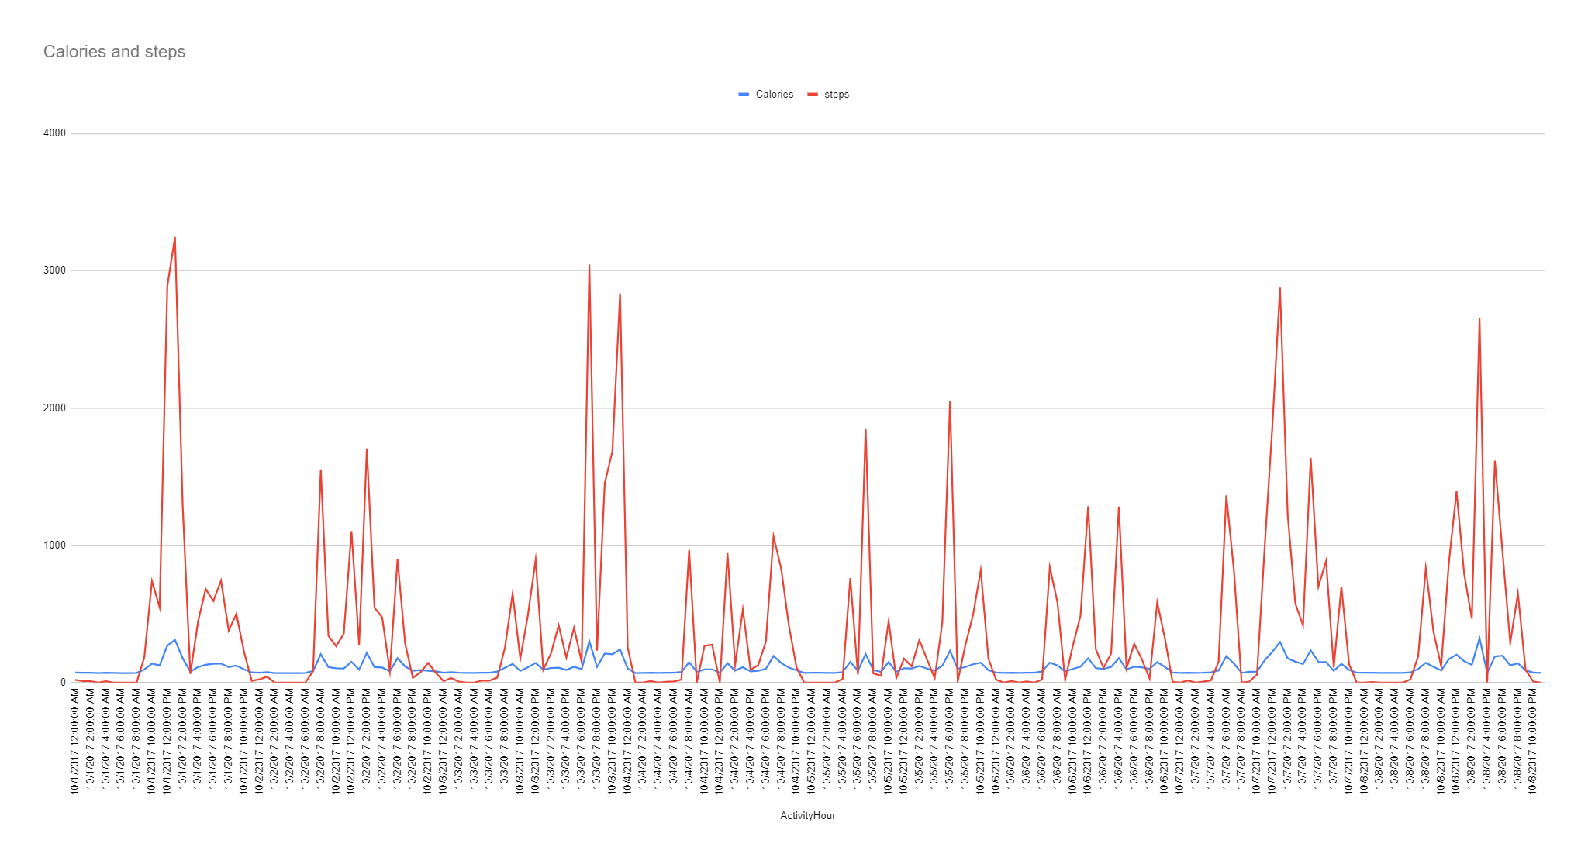
Visualization

Slide 8
Conclusion
The analysis demonstrates a strong positive correlation between hourly steps taken and calories burned, with a correlation coefficient of 0.97. This indicates that physical activity, as measured by steps, is closely associated with energy expenditure, as reflected in the calories burned.

Slide 9
I would recommend;
Individuals that are aiming at at increasing their calorie burn can track their steps and set step goals.
Having devices that monitor steps can be a good way to keep track and record their steps.

Slide 10
https://docs.google.com/spreadsheets/d/1iagAKzTQORgWl5DERE9F6L8stgn-fEerCSqFMZXTQqU/edit?usp=sharing

